Slide 1



Surge Savvy: Predicting Sea Storm Surge with Machine Learning
Explore the cutting-edge technology of machine learning as it revolutionizes our ability to forecast and prepare for devastating sea storm surges. This presentation will delve into the powerful predictive models that are transforming our understanding of these natural disasters.
by Parth Grewal

Slide 2
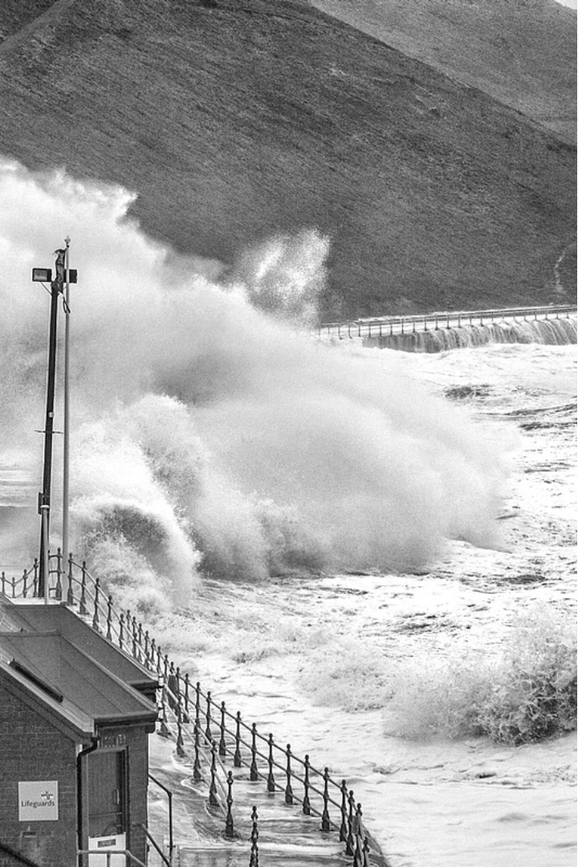
Introduction to Sea Storm Surge
Sea storm surge is the abnormal rise of water levels during a storm, caused by the combined effects of low atmospheric pressure and strong winds pushing water onshore. This dramatic increase in water levels can lead to devastating coastal flooding, erosion, and damage to infrastructure.

Slide 3
The Importance of Accurate Surge Prediction
1
Safeguarding Lives
2
Minimizing Economic Losses
Precise surge forecasting enables timely evacuations, protecting coastal communities from the devastating impacts of rising floodwaters.
Accurate predictions help businesses and governments prepare for disruptions, preventing costly damage to infrastructure and mitigating financial losses.
3
Informing Urban Planning
4
Enhancing Disaster Response
Surge data informs resilient city design, ensuring new developments can withstand the increasing frequency and intensity of coastal storms.
Real-time surge modeling enables emergency services to mobilize resources effectively, streamlining rescue and recovery efforts in the aftermath.

Slide 4
Machine Learning Techniques for Surge Forecasting
Time Series Analysis
1
Leveraging historical data on wind, tides, and storm patterns to build predictive models that can forecast storm surge levels.
2
Neural Networks
Applying deep learning algorithms to rapidly process complex environmental data and identify patterns that influence surge development.
Ensemble Modeling
3
Combining multiple machine learning models to enhance accuracy and provide a more robust surge prediction system.

Slide 5
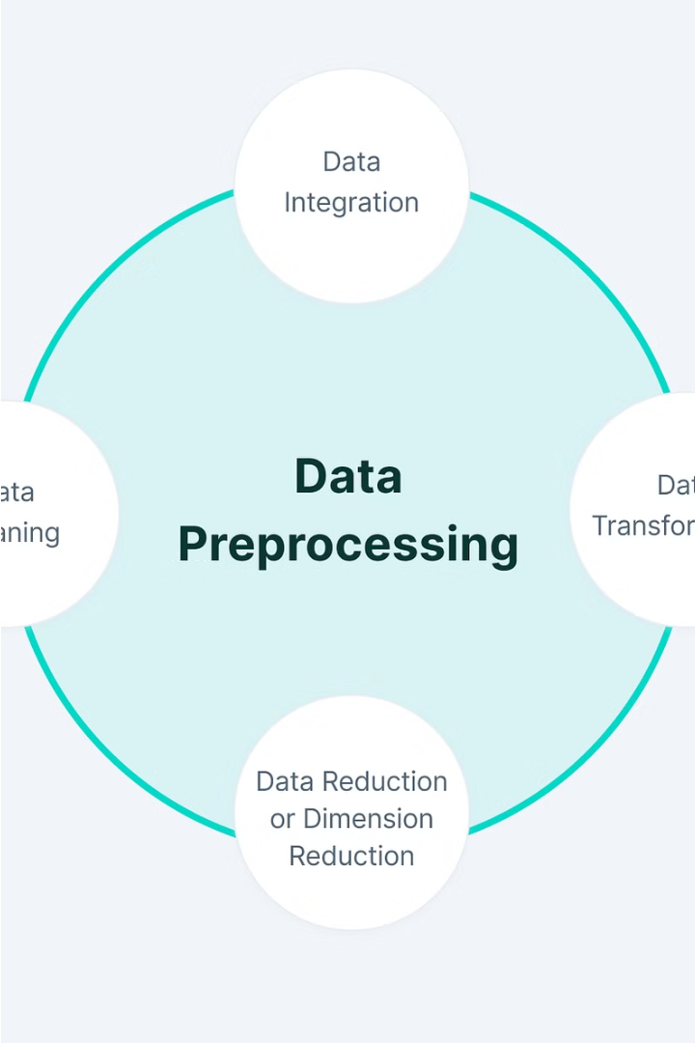
Data Collection and Preprocessing
Gathering comprehensive, high-quality data is crucial for accurate sea storm surge predictions. This involves collecting historical weather, oceanographic, and coastal data from various sources, including government agencies, research institutions, and real-time sensors.
The data must then be preprocessed, cleaned, and organized to ensure consistency and compatibility for use in the machine learning model. This step may include handling missing values, removing outliers, and transforming the data into the appropriate format.

Slide 6
Problem Statement
Accurately predicting the height and extent of sea storm surge is crucial for coastal communities to prepare and mitigate the impact of extreme weather events.
Existing models often struggle to capture the complex interactions between weather, ocean, and coastal dynamics, leading to inaccurate surge forecasts.
The goal is to develop a machine learning-based solution that can leverage diverse data sources to provide more reliable and granular surge predictions, enabling better emergency planning and resource allocation.

Slide 7
Solution
Predictive Modeling
Real-Time Monitoring
Geographic Visualization
Our solution leverages advanced machine learning techniques to develop accurate predictive models for sea storm surge. These models can forecast surge levels with high precision, enabling better preparedness and response.
We integrate real-time data from weather sensors, tidal gauges, and other sources to continuously monitor and update surge predictions, ensuring the most up-to-date and reliable information.
The solution features an intuitive geographic information system (GIS) interface that visually displays predicted surge levels, affected areas, and critical infrastructure, allowing for better decision-making and resource allocation.

Slide 8
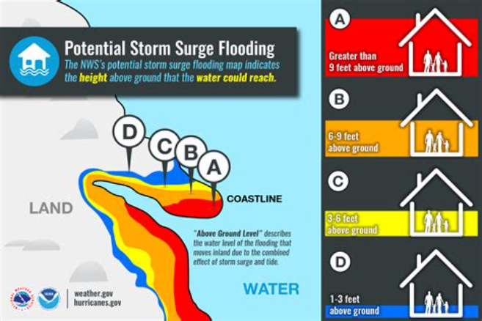
Model Selection and Training
To build an accurate sea storm surge prediction model, we carefully select and train the most suitable machine learning algorithms. We evaluate various models, including neural networks, random forests, and gradient boosting, to find the one that best captures the complex dynamics of storm surge formation.
The selected model is then trained on historical storm surge data, incorporating factors such as wind speeds, tidal patterns, and coastal topography. Rigorous testing and validation ensure the model's reliability in forecasting future surge events.

Slide 9




Design
Prototyping
Responsive Design
Branding
Usability
We'll develop interactive prototypes to visualize the app's user interface and functionality, ensuring an intuitive and seamless experience.
A cohesive brand identity will be established, with a clean and visually appealing aesthetic that reflects the app's purpose and values.
Extensive user testing will be conducted to identify and address any usability pain points, ensuring a delightful and efficient user experience.
The application will be designed to be fully responsive, optimizing the layout and interactions for various screen sizes and devices.

Slide 10

Thank You
We've covered the key aspects of using machine learning to predict sea storm surge. Thank you for your attention and interest in this important topic. Please don't hesitate to reach out if you have any further questions.
Parth Grewal
Harsh Kumar
Ayushman Kumar
Tavishee Singh

